Slide 1
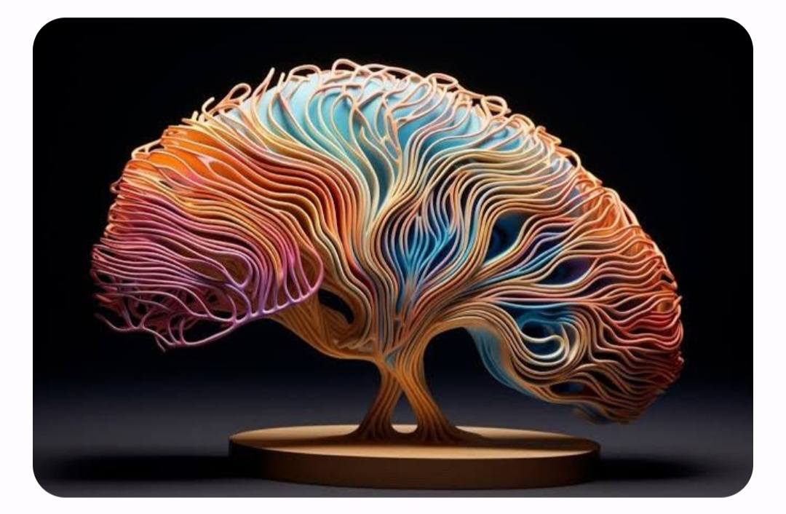
Brain Tumor Classification
Alin Finkelshtein and Felix Doctorman

Slide 2
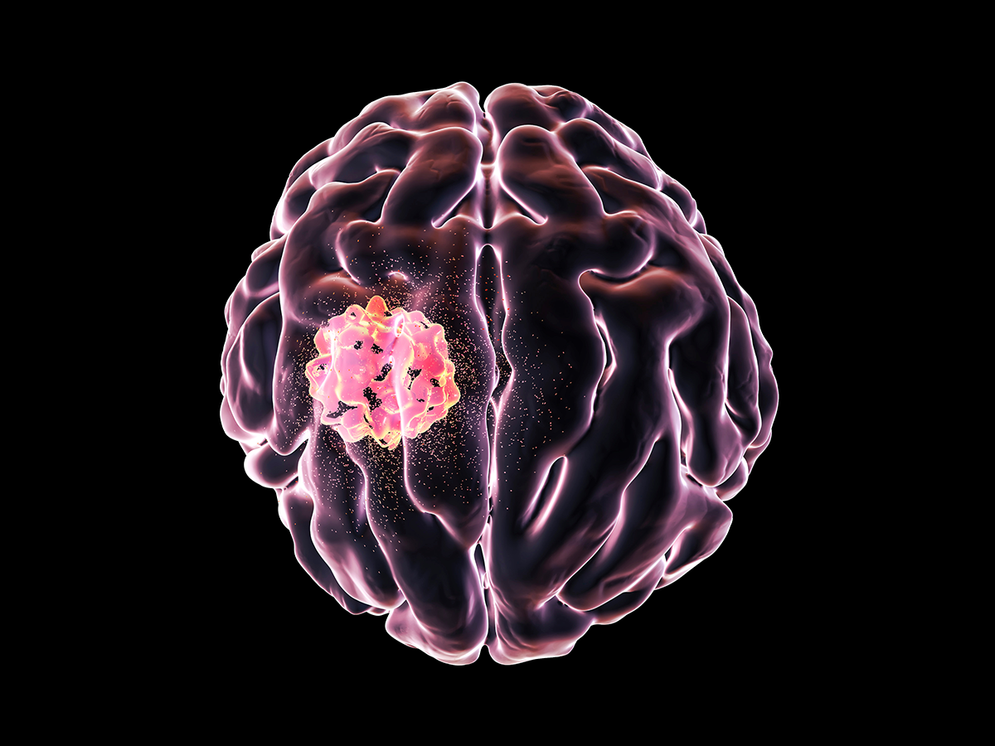
Brain tumors
Optic nerve glioma
Medulloblastoma
Neurofibroma
Mixed glioma
Hemangioblastoma
Ependymoma
Oligodendroglioma
Glioblastoma multiforme
Craniopharyngioma
Gliomas
Pituitary adenoma
Astrocytoma
Choroid Plexus Tumors
Brainstem glioma
Schwannoma
Benign (noncancerous)
Malignant (cancerous)
Meningioma
50/50 chance of being cancerous
Chordoma
Primary central nervous system lymphoma
Vestibular schwannoma
Pilocytic astrocytoma
Germ cell tumor
Primitive neuroectodermal tumor
diffuse Astrocytomas
Anaplastic astrocytoma
Notes:
There are more than 120 brain tumors. Classified by their location and type of cells they are made of.
Certain types of tumors are typically benign (noncancerous), while others are typically malignant (cancerous). Others may have a 50/50 chance of being cancerous.

Slide 3
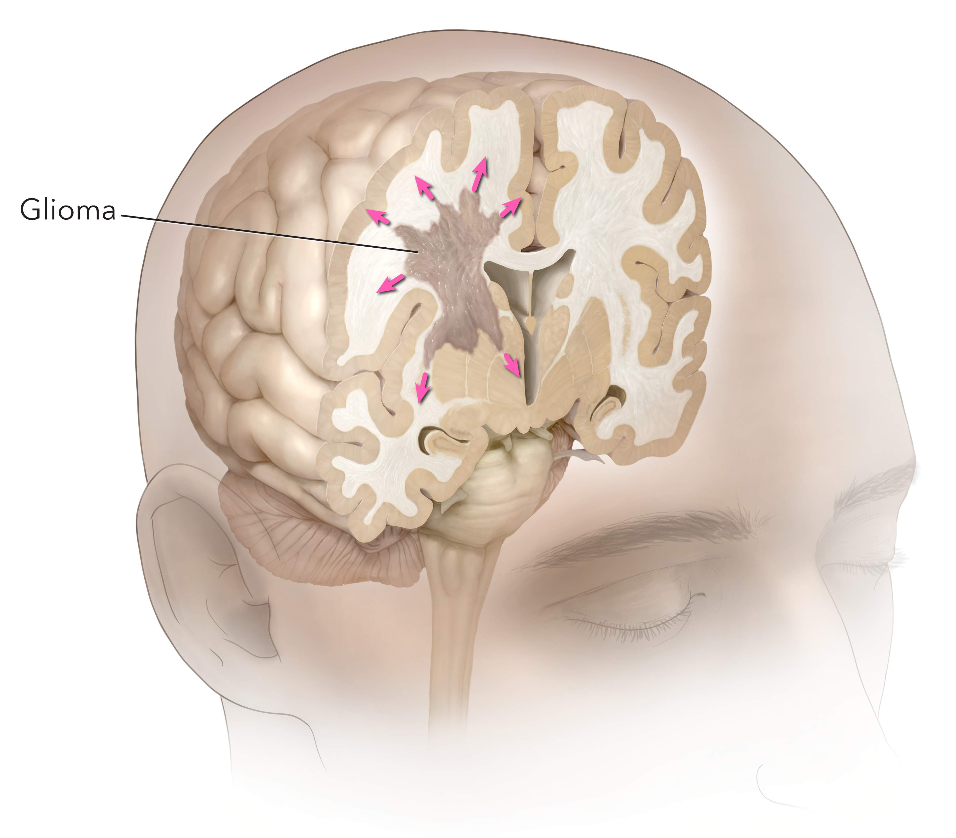
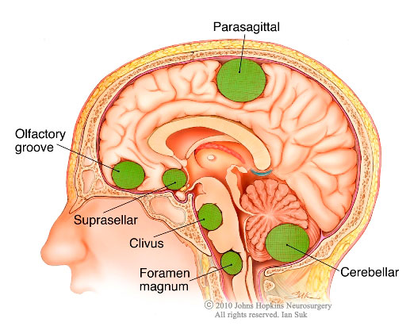
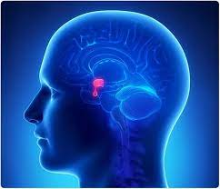
Glioma
Meningioma
Pituitary
Glioma starts in the glial cells
About 33% of all brain tumors
Gliomas can affect all ages, but they are most often seen in adults.
There are different gliomas, with different growth potential and aggressiveness
Variable Grades of aggressiveness (From More Benign to Malignant)
Symptoms of glioma appear slowly and may be subtle at first. Some gliomas do not cause any symptoms .
Meningioma starts in the meninges, which are membranes surrounding and protecting the brain.
30% percent of all brain tumors.
They grow slowly and may exist for years before being detected.
Most meningioma tumors are benign.
Pituitary tumor starts in the pituitary gland.
About 25% of people may have small pituitary tumors
It is located behind the back of the nose.
It makes hormones that affect many functions in your body.
Most pituitary tumors are benign.
They don’t spread to other parts of your body
They can cause vision and endocrinological problems
Most pituitary tumors don’t cause symptoms. As a result, they are not diagnosed.

Slide 4
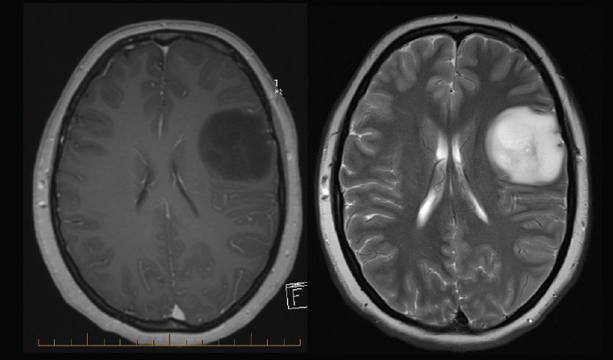
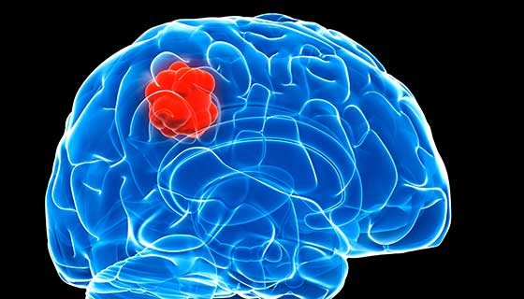
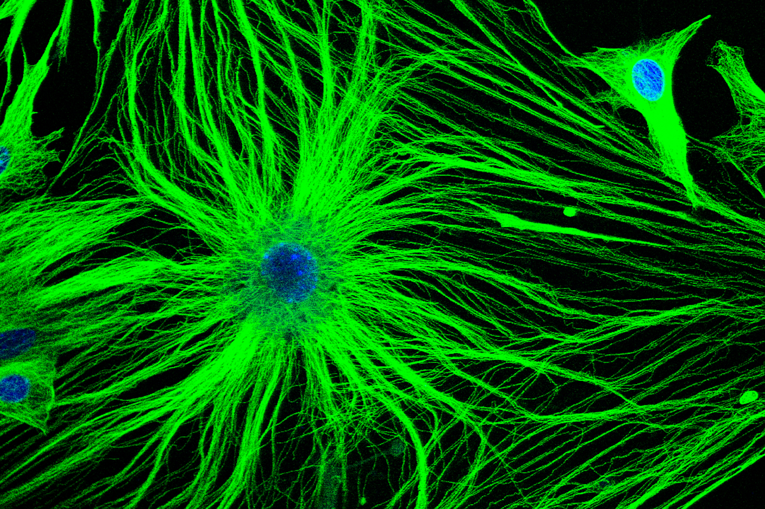
Glioma
Is a common type of tumor originating in the brain.
About 33 percent of all brain tumors are gliomas,
Glioma originate in the glial cells that surround and support neurons in the brain, including astrocytes, oligodendrocytes and ependymal cells.
There are different types of gliomas
Astrocytomas
Brain stem gliomas,
Ependymomas
Mixed gliomas
Oligodendrogliomas
Optic pathway gliomas

Slide 5
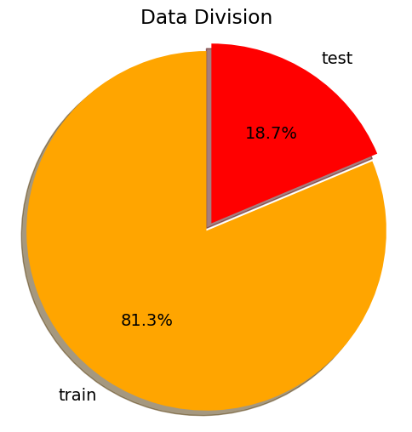
The data
Train
Test
Glioma
Meningioma
Totumor
Pituitary
Glioma
Meningioma
Totumor
Pituitary

Slide 6
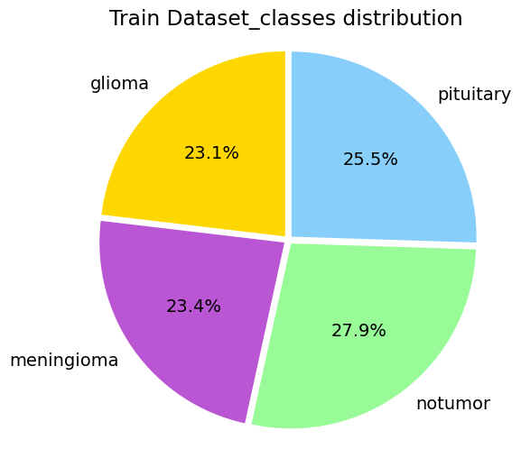
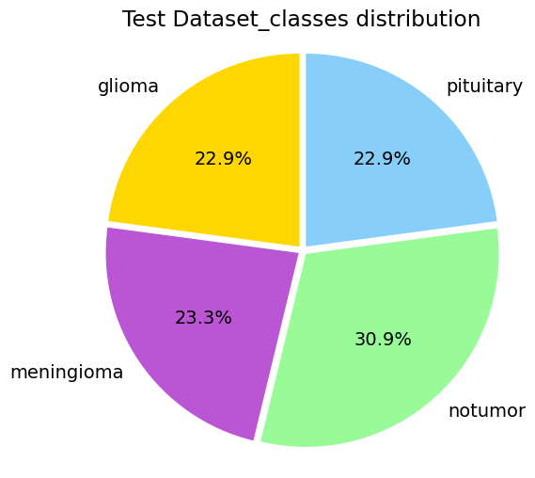
The classes are balanced

Slide 7
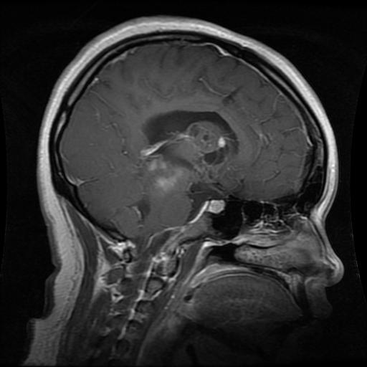
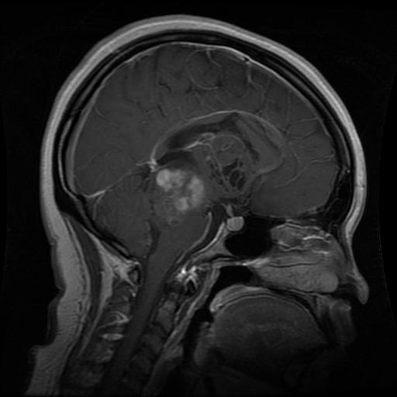
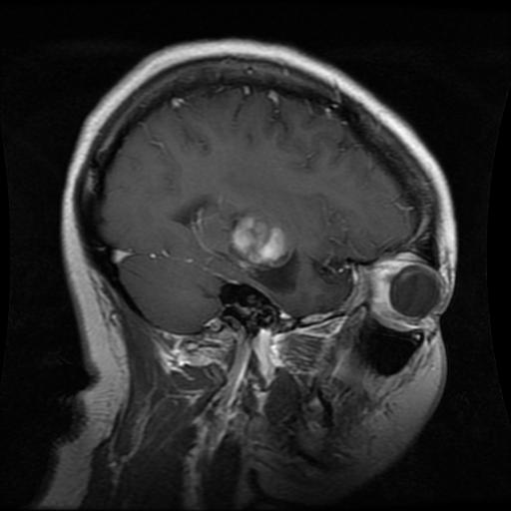
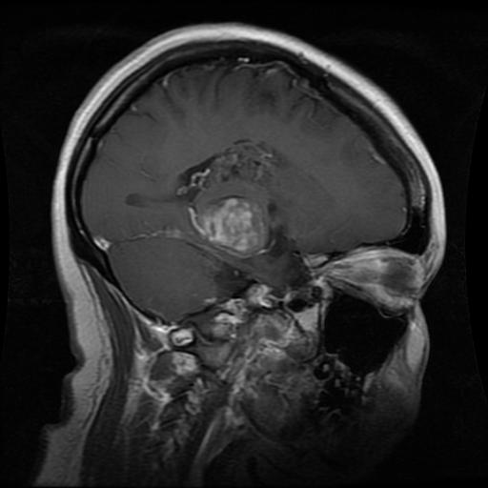
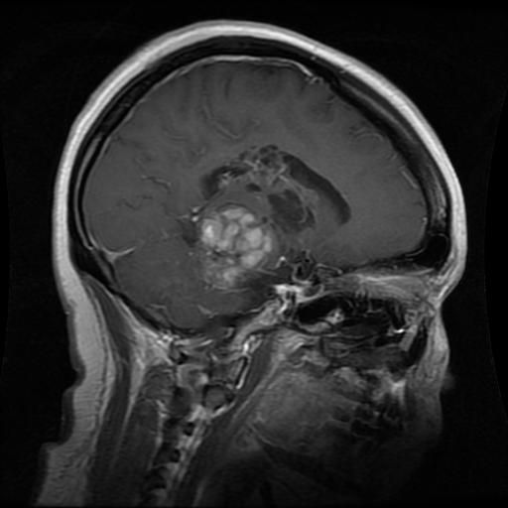
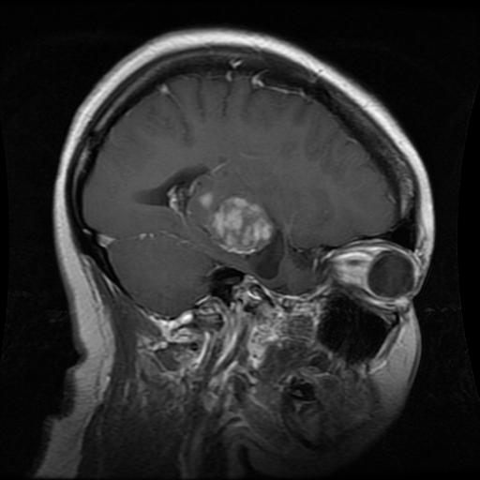
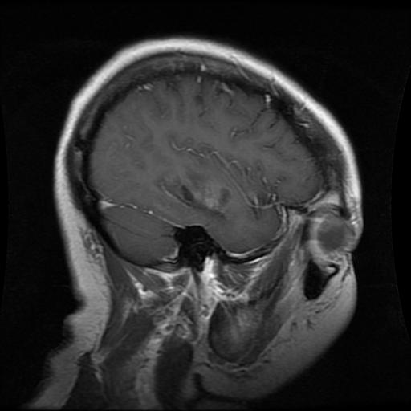
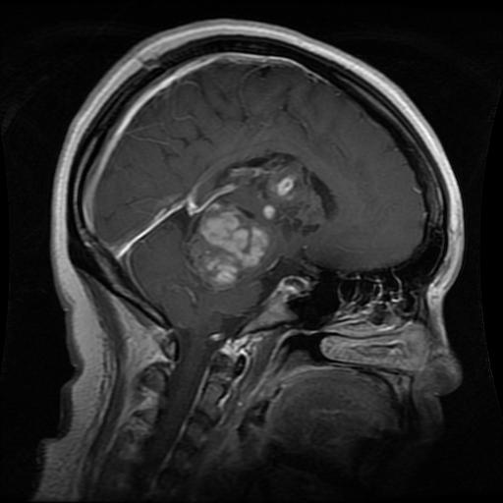
MRI Slicing

Slide 8
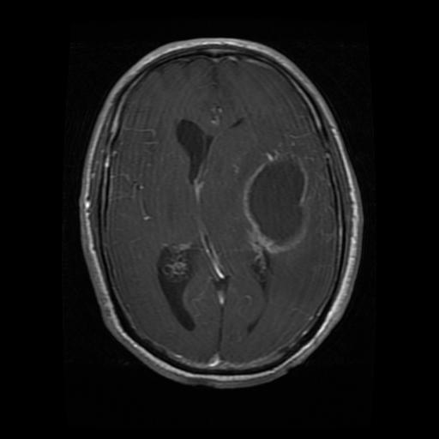
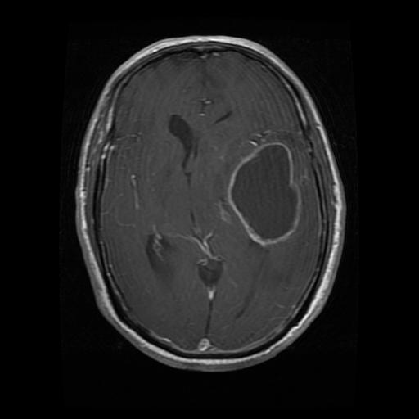
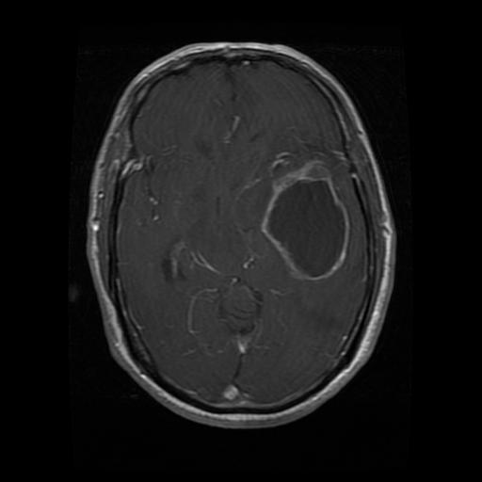
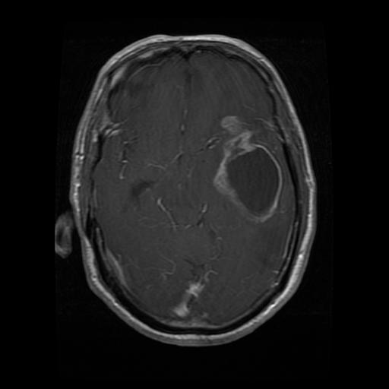
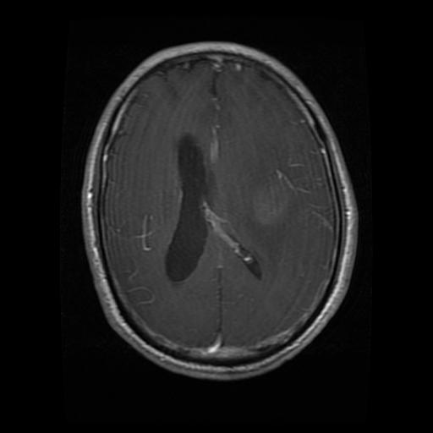
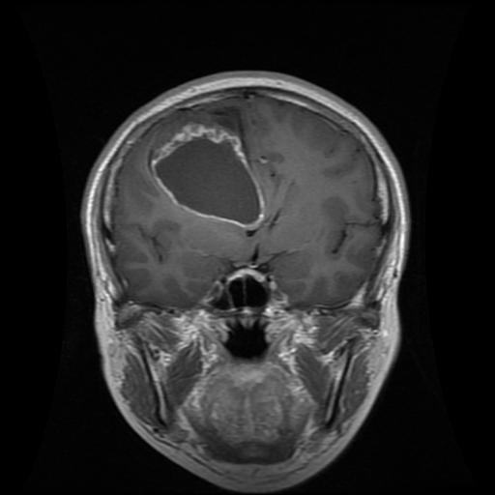
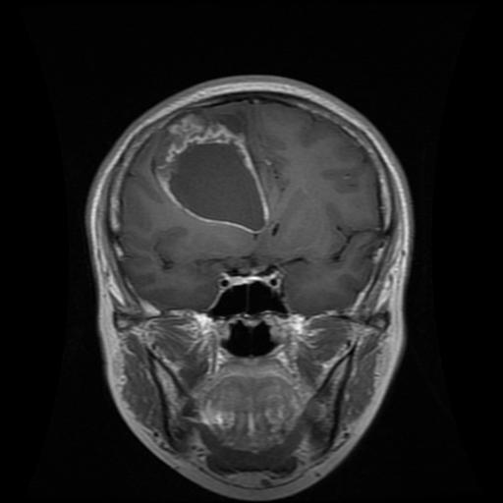
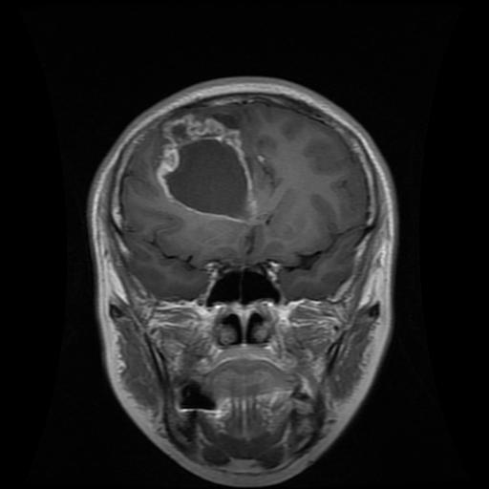
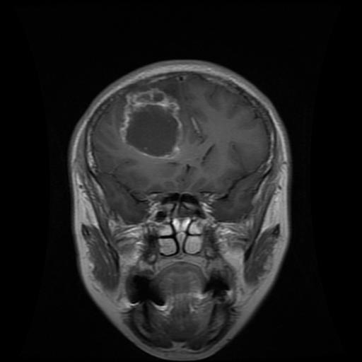
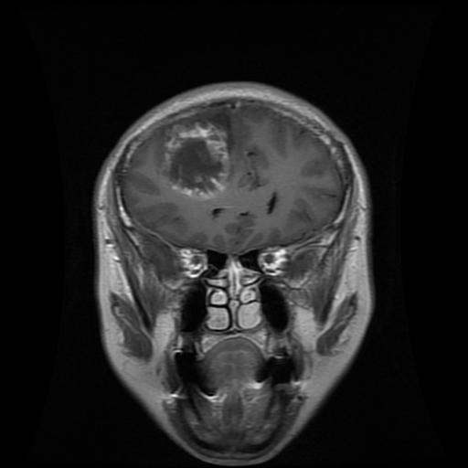
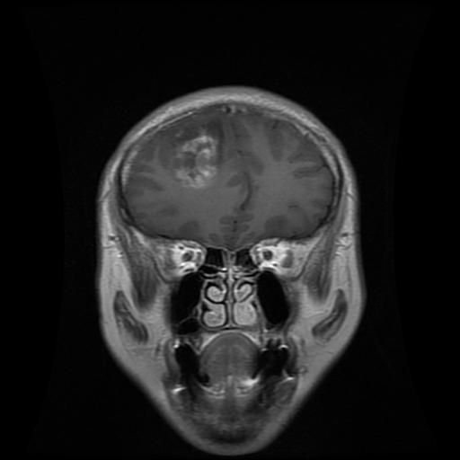

Slide 9
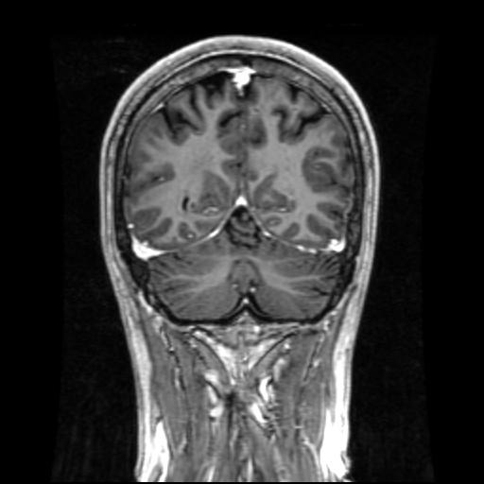
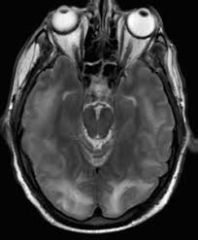
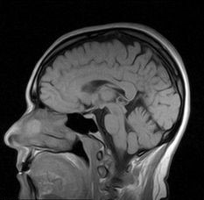
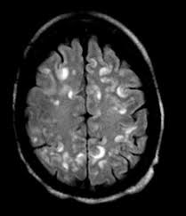
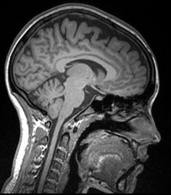
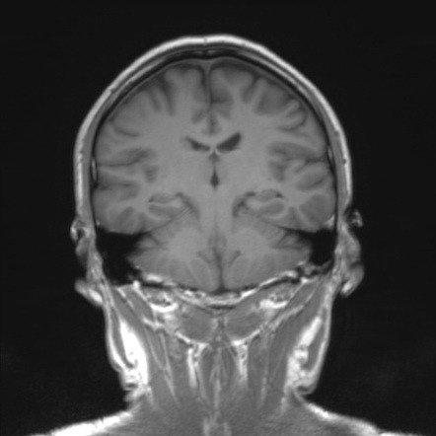
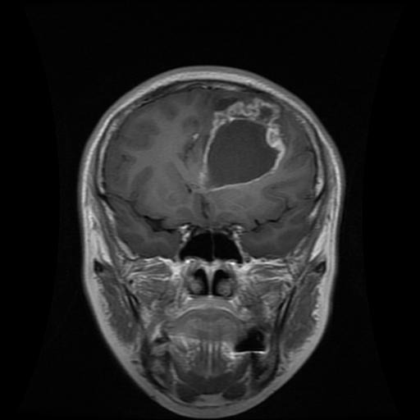
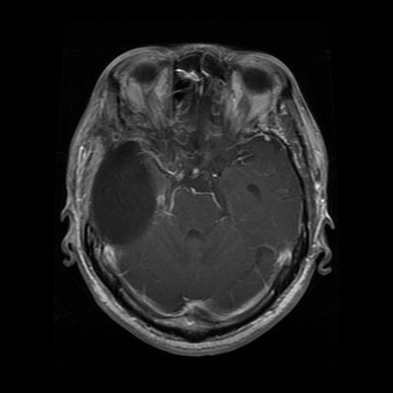
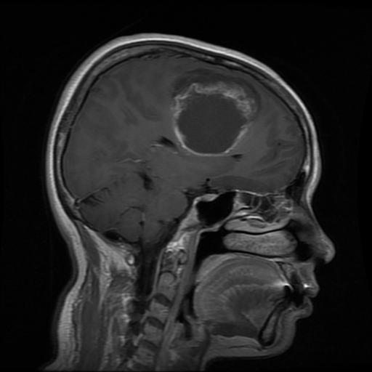
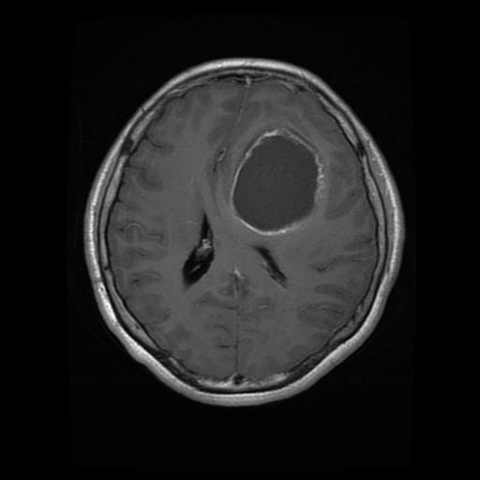
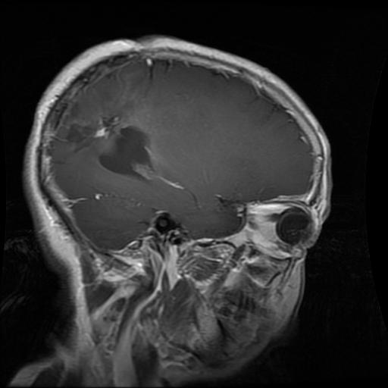
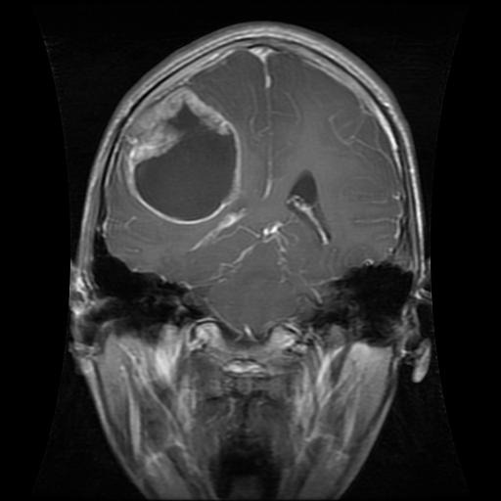
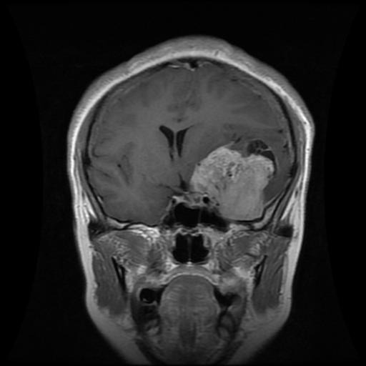
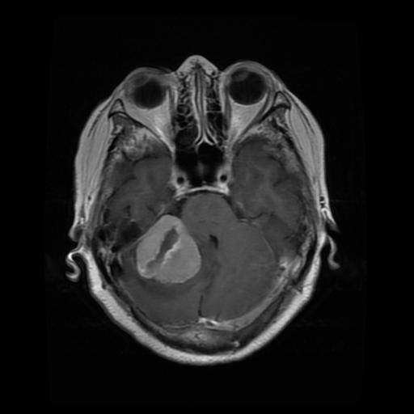
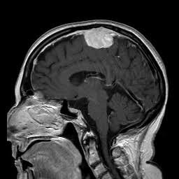
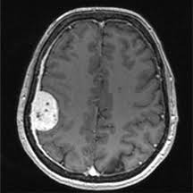
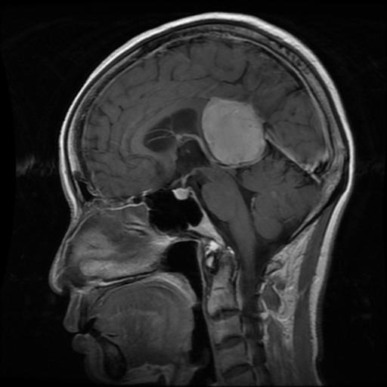
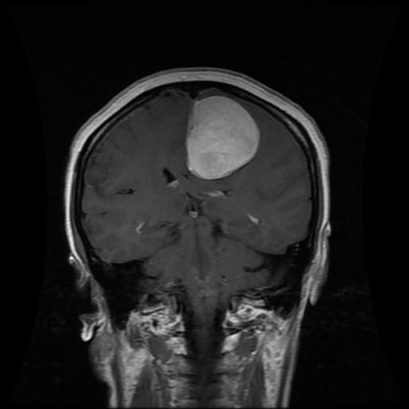
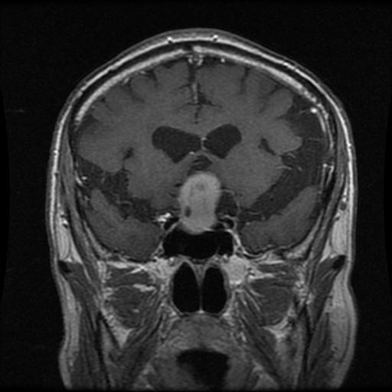
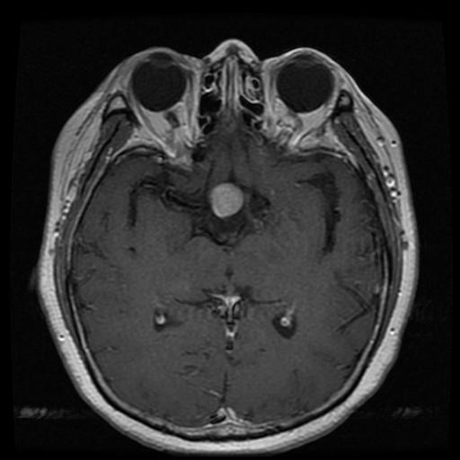




No tumor
Glioma
Meningioma
Pituitary

Slide 10

Augmentation:
Rotation randomly
Horizontal flip

Slide 11

Preprocessing
Original image (512, 512, 3)→dimensions reduction → (128, 128, 1)
Split to X & y → X.shape (5712, 128, 128, 1)
y_train = to_categorical(y, num_classes = 4)
Split to Train and validation
Train Validation Test
X.shape (4569, 128, 128, 1) (1143, 128, 128, 1) (1311, 128, 128, 1)
np.array(y).shape (4569, 4) (1143, 4) (1311, 4)

Slide 12

CNN_model

Slide 13

CNN architecture
4 x 4 x 256
1 x 1024
1 x 4096
1 x 4
128 x128 x1
32 x 32 x 128
8 x 8 x 128
128 x128 x 64
64 x 64 x64
64 x 64 x 128
16 x 16 x 128
8 x 8 x 256

Slide 14


After training
categories = ['glioma', 'meningioma', 'notumor', 'pituitary']

Slide 15
XGBoost input
4 x 4 x 256
1 x 1024
1 x 4096
1 x 4
128 x128 x1
32 x 32 x 128
8 x 8 x 128
128 x128 x 64
64 x 64 x64
64 x 64 x 128
16 x 16 x 128
8 x 8 x 256
Notes:
We took the output of this layer and used it as an input for the XGBoost.

Slide 16

XGBoost
X_train →(4569, 1024)
X_test → (1311, 1024)
xgb = XGBClassifier(objective='multiclass:softmax', learning_rate = 0.1, max_depth = 15, n_estimators = 500)
xgb.fit(X_train_features,np.argmax(y_train, axis=1))

Slide 17


CNN CNN+XGBoost
Accuracy : 0.953 Accuracy: 0.965

Slide 18
VGG16
base_model = VGG16(input_shape=(IMAGE_SIZE,IMAGE_SIZE,3), include_top=False, weights='imagenet')
# Set all layers to non-trainable
for layer in base_model.layers:
layer.trainable = False
# Set the last vgg block to trainable
base_model.layers[-2].trainable = True
base_model.layers[-3].trainable = True
base_model.layers[-4].trainable = True
model = Sequential()
model.add(Input(shape=(IMAGE_SIZE,IMAGE_SIZE,3)))
model.add(base_model)
model.add(Flatten())
model.add(Dropout(0.3))
model.add(Dense(128, activation='relu'))
model.add(Dropout(0.2))
model.add(Dense(len(unique_labels), activation='softmax'))

Slide 19

VGG16

Slide 20


VGG16 training

Slide 21
Model comparison
Model name | accuracy | recall | precision | F1 score | Training time
CNN | 0.9534 | 0.9534 | 0.955950 | 0.9532126 | 101.411
CNN +XGBoost | 0.9649 | 0.9649 | 0.965151 | 0.964783 | 250.49
VGG16 | 0.96 | 0.96 | 0.9625 | 0.9575

